Slide 1

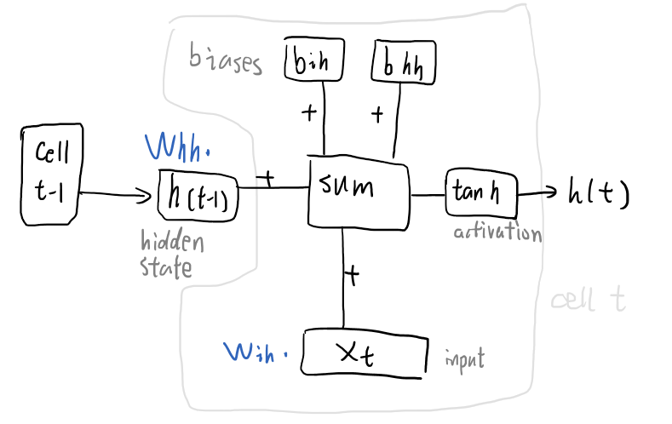
Prediction
Fully connected linear layer
(128, 2)
RNN layers
(forward pass using tanh activation)
For a single vector(1, 50)
Word vector GloVe
Embedding layer
(18854, 50)
Great
layering
piece
this
sweater
Clean up & tokenize
… | … | … | … | …
… | … | … | … | …
… | … | … | … | …
Raw Data
(18854 rows)

